Slide 1



SOFTWARE DEVELOPMENT PROFESSIONAL PROGRAM
Iframes, Embeds, & Subtitle Tracks

Slide 2





Iframes, Embeds, & Subtitle Tracks
Learning Objectives
Add an iframe to a page that includes a resource (e.g., YouTube video, Google Calendar, etc.).
Load a subtitle or caption track for a video.
Create subtitles or captions in the WebVTT format.

Slide 3

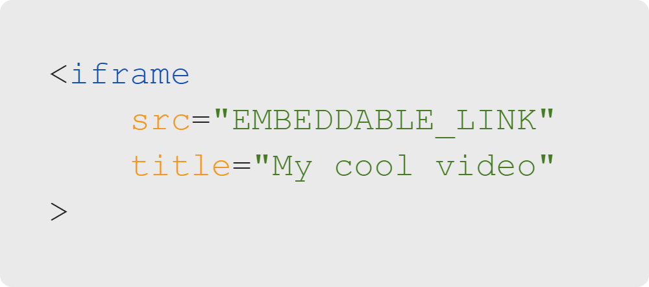
Iframes, Embeds, & Subtitle Tracks
Review: Iframes
We used iframes to load YouTube.
You can utilize iframes for many things such as:
Another HTML page.
A YouTube video.
A calendar.
A Twitter page.
Let’s try adding a Google Calendar!
Notes:
In the last lesson and activity, we loaded YouTube video links. This was an easy, fun example, but you can load
many other things, too. Since iframes can be used for different things, it is important to give them a title
attribute for screen readers to interpret.
<< Refer to LC exercise 1: Iframe Paths >>

Slide 4

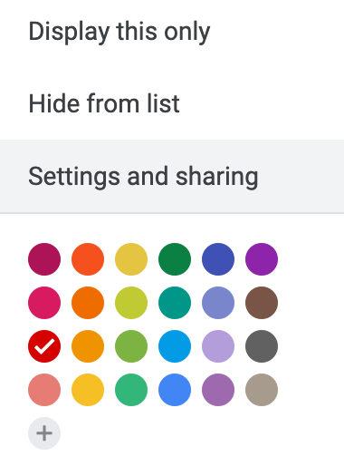
Iframes, Embeds, & Subtitle Tracks
Iframes: Google Calendar
You can access Google Calendar's Settings and sharing by clicking the three vertical dots.
Notes:
If you have your own Google Calendar, you can follow this process to display an iframe in your page. If not,
we'll provide one for the activity. IMPORTANT NOTE: Your embedded calendar will only be viewable to people
with whom you have shared it. Setting your calendar to public will allow everyone to see it, even if they
are not logged in.

Slide 5
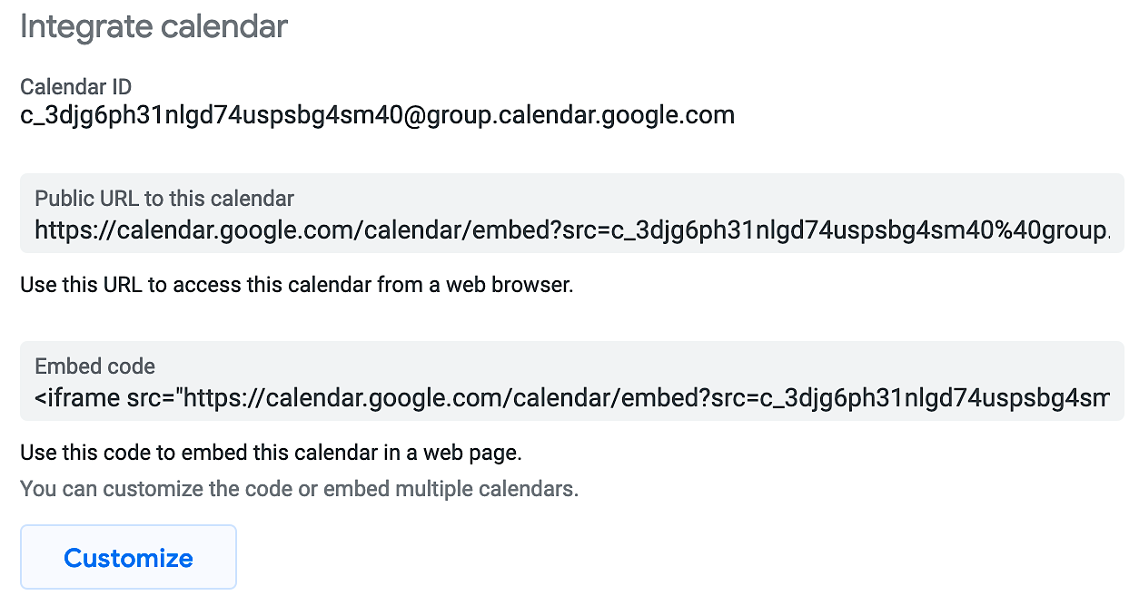
Iframes, Embeds, & Subtitle Tracks
Iframes: Google Calendar
Find the Integrate calendar section.
Click the Customize button.
Notes:
Under "Embed code," you will see an iframe you can copy. However, you typically will want to set some
defaults, which you can do in the customization page.
<< Refer to LC exercise 2: Google Calendar >>

Slide 6
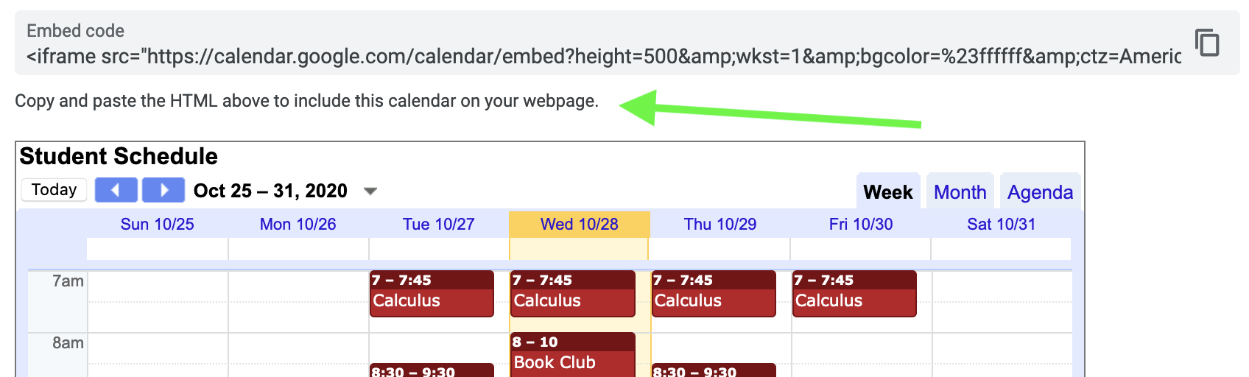
Iframes, Embeds, & Subtitle Tracks
Customize Google Calendar
Notes:
On this page, you'll see a number of options on the left. Select what you want the defaults to be and
then copy the iframe generated for you.

Slide 7

Iframes, Embeds, & Subtitle Tracks
Quiz: Let's Discuss
Should iframes be used as much as possible?
A. Yes, they're great.
B. No, they're slow.
C. No, they're insecure.
D. Both B and C

Slide 8
Iframes, Embeds, & Subtitle Tracks
Quiz: Answer
Should iframes be used as much as possible?
A. Yes, they're great.
B. No, they're slow.
C. No, they're insecure.
D. Both B and C
Want to know more? Check out The Ultimate Guide to IFrames.
Notes:
Iframes are undeniably slow compared to most other web content, so don't make it a practice of putting lots of
iframes on a single page. Also, any time you're loading content that didn't come directly from code you wrote
yourself, there's a potential security risk. While there are ways to make iframes more secure (such as the
sandbox attribute), it's good to keep security in mind as you learn to write back-end code and store sensitive
data in databases.

Slide 9
Iframes, Embeds, & Subtitle Tracks
Media Across the Globe
Let's say you have a funny video of a dog in MP4 format.
How do you share that video with as many people as possible?
Write your answers in the chat.
Notes:
We've discussed a lot about media, but up until now we haven't really covered how to make videos accessible
to people who may not speak our language or who may be hearing impaired. Captions and/or subtitles would
widen our audience.

Slide 10
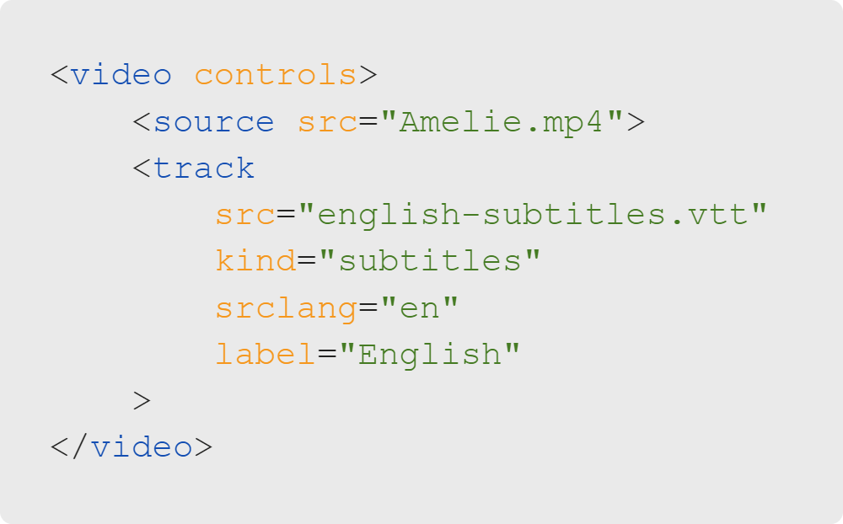
Iframes, Embeds, & Subtitle Tracks
Subtitles for Videos
Subtitles are simple text files.
The track tag uses WebVTT files which stands for Web Video Text Tracks Format.
The kind attribute defaults to subtitles but can also be used for captions. What do you think the property is to assign the kind as captions?
Notes:
Fun fact: There is a subtle distinction between subtitles and captions. Generally, subtitles refer to foreign
language translations for those who don't understand the language of the original content, while captions are
for those who cannot hear the audio or non-verbal sound effects.
<< Refer to LC exercise 3: Video Knowledge Check >>

Slide 11
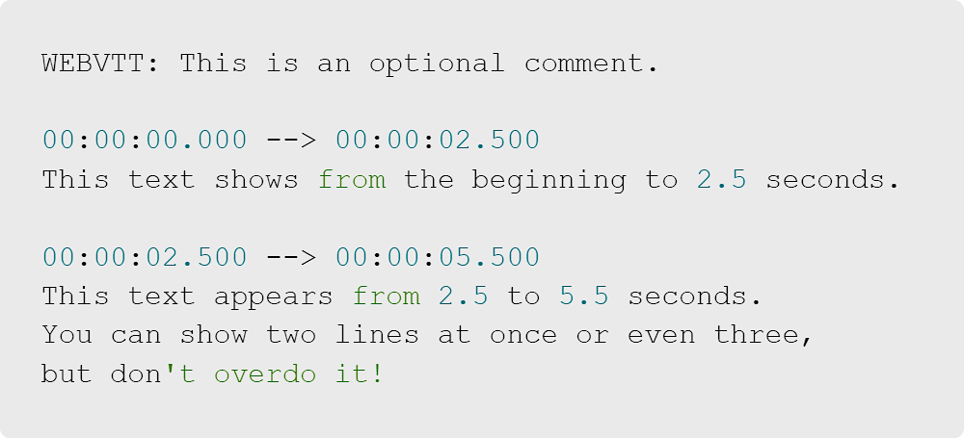
Iframes, Embeds, & Subtitle Tracks
WebVTT (Video Text Tracks)
What do you think is happening below in the image?
Notes:
VTT files have a specific format.
The first line should be "WEBVTT" followed by an empty line.
Timestamps are in the form: hh:mm:ss.ttt
Timestamps are separated by "-->"
The text follows the timestamp and is followed by an empty line.
<< Refer to LC exercise 4: Subtitles/Captions Files >>

Slide 12
Iframes, Embeds, & Subtitle Tracks
Quiz: Let's Discuss
In most cases, are captions required by US law?
A. Yes
B. No

Slide 13
Iframes, Embeds, & Subtitle Tracks
Quiz: Answer
In most cases, are captions required by US law?
✅ A. Yes
🚫 B. No
They generally are required. For more information on US accessibility laws, read the When is Captioning Required? article.
Notes:
Relevant laws include the Rehabilitation Act (1973), the Americans with Disabilities Act (1990), and the
21st Century Communications and Video Accessibility Act (2010).

Slide 14

Iframes, Embeds, & Subtitle Tracks
Activity Time
Let's practice!

